Slide 1

Blazor
Building Reusable Component Libraries
https://github.com/hikalkan/presentations

Slide 2
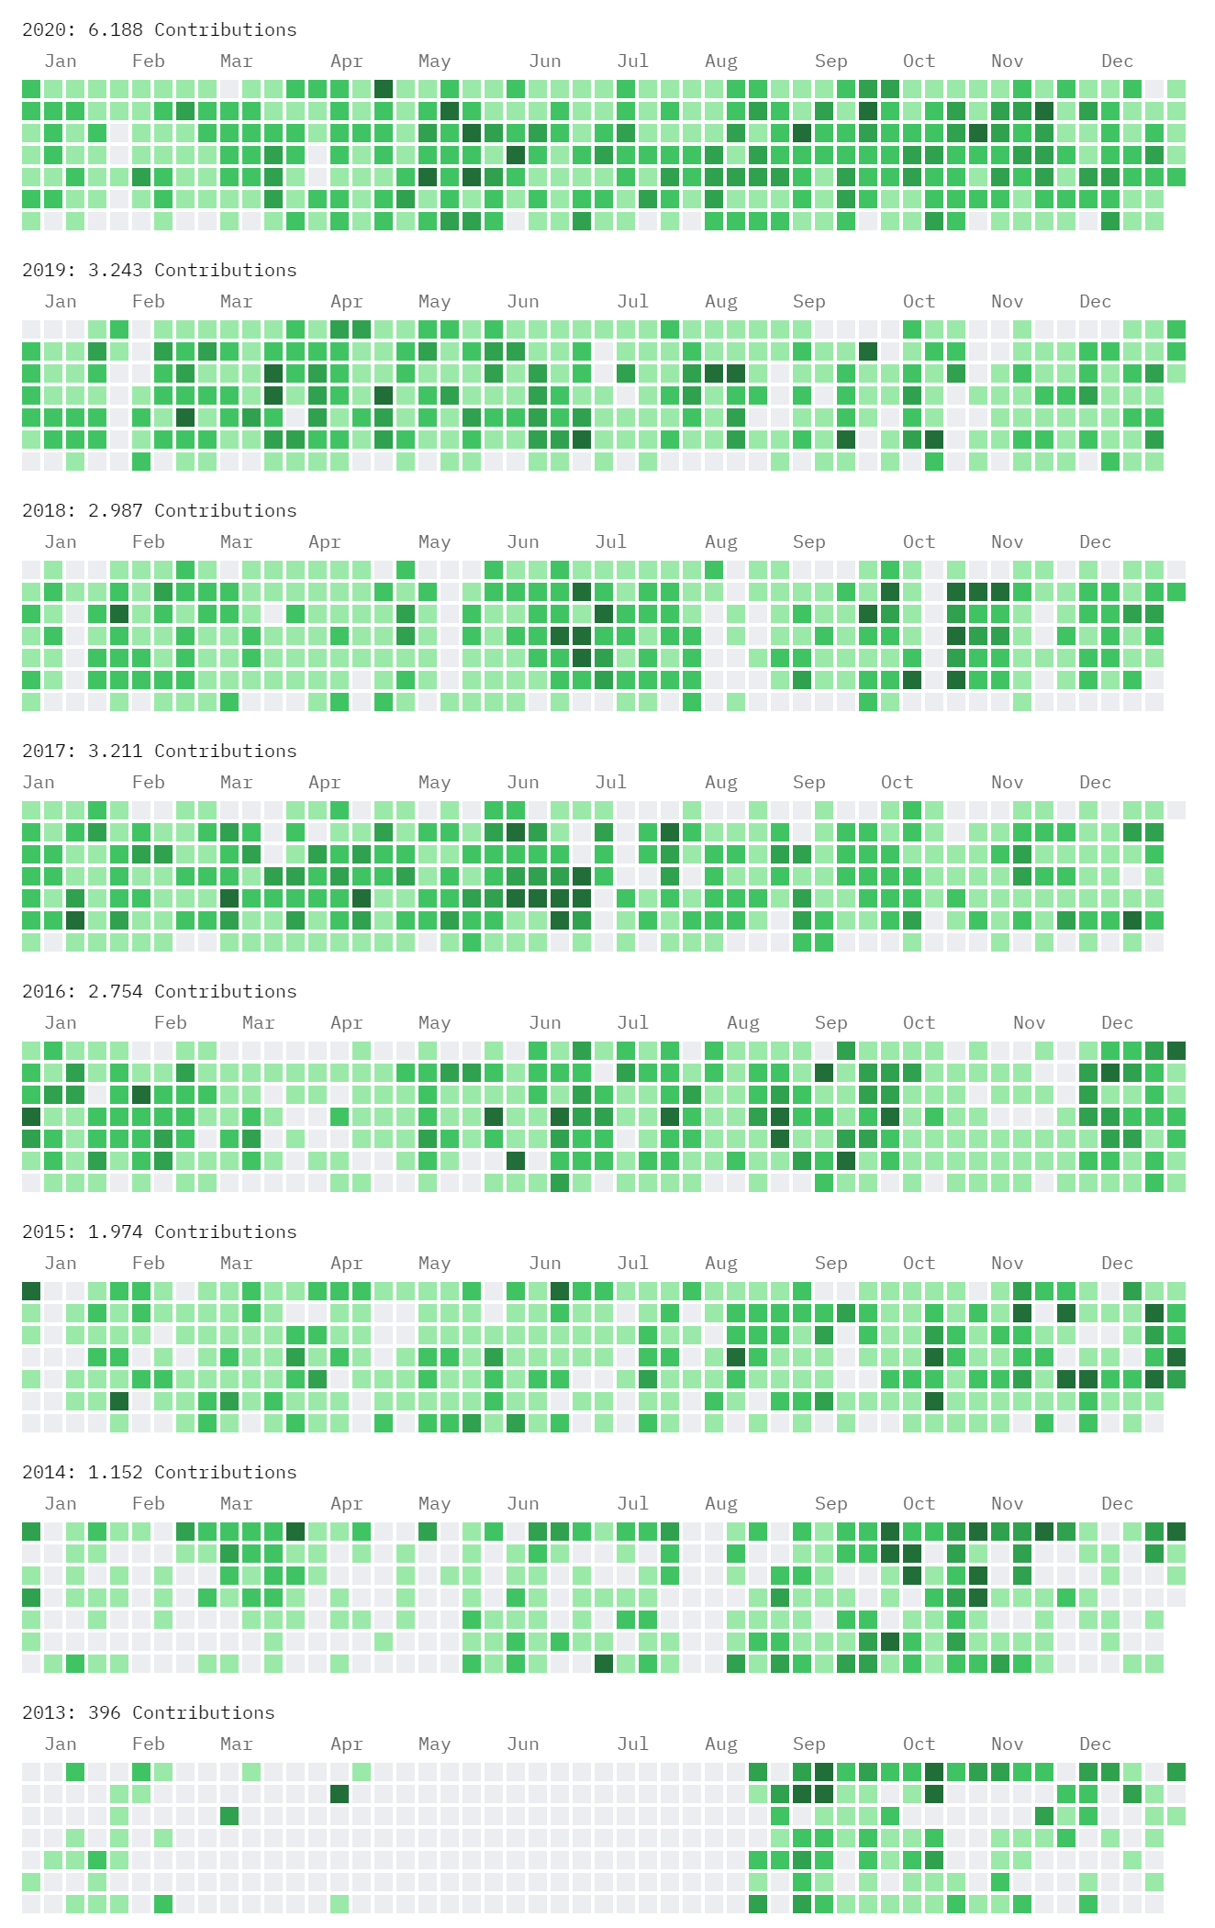


ABOUT ME Halil İbrahim Kalkan
Co-Founder of
Web: halilibrahimkalkan.com
Github: @hikalkan
Twitter: @hibrahimkalkan

Slide 3
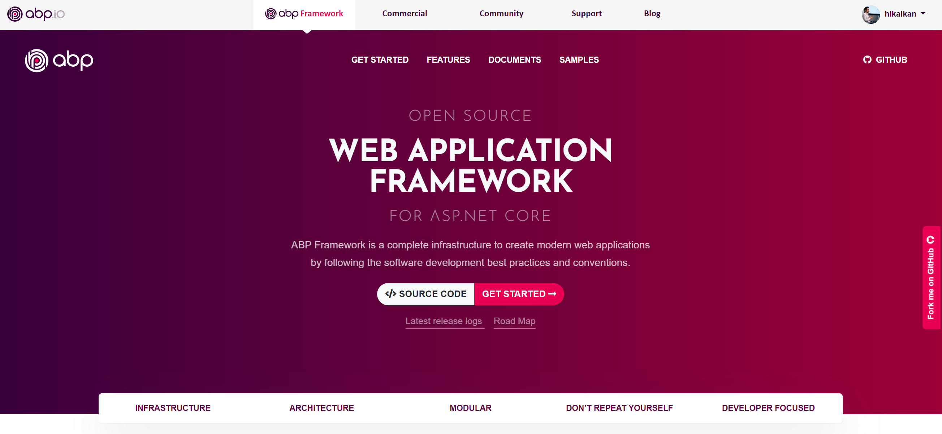
ABP Framework https://abp.io

Slide 4
What is Blazor?
Pros
C# instead of JavaScript
.NET platform runs on the Browser over WebAssembly
All the .NET Ecosystem (NuGet packages) in the client side!
Code sharing (DTOs, validation logic, utils…) between client & server.
JavaScript Interop
Cons
Initial Load & Runtime performance
Limited Debugging
UI Component libraries are not mature & rich.

Slide 5
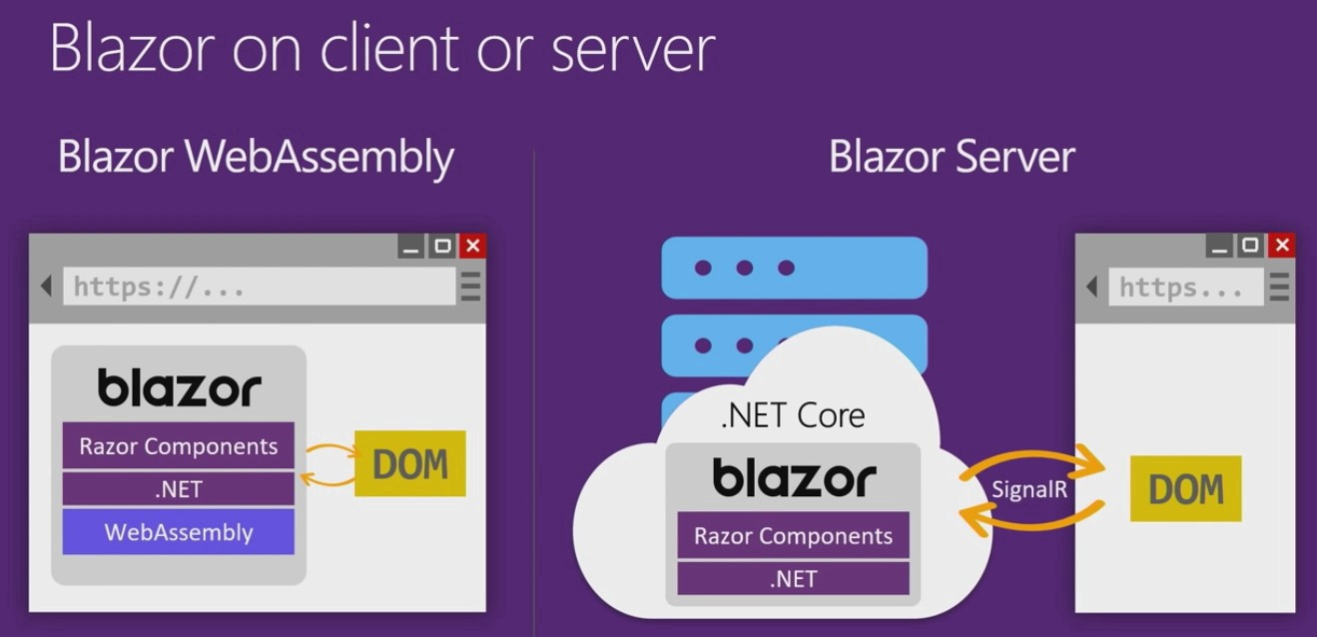

Slide 6
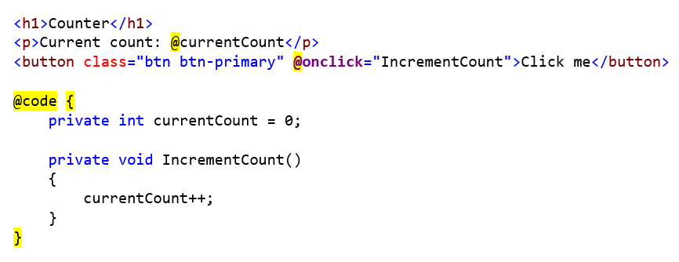
Blazor: Razor Components

Slide 7
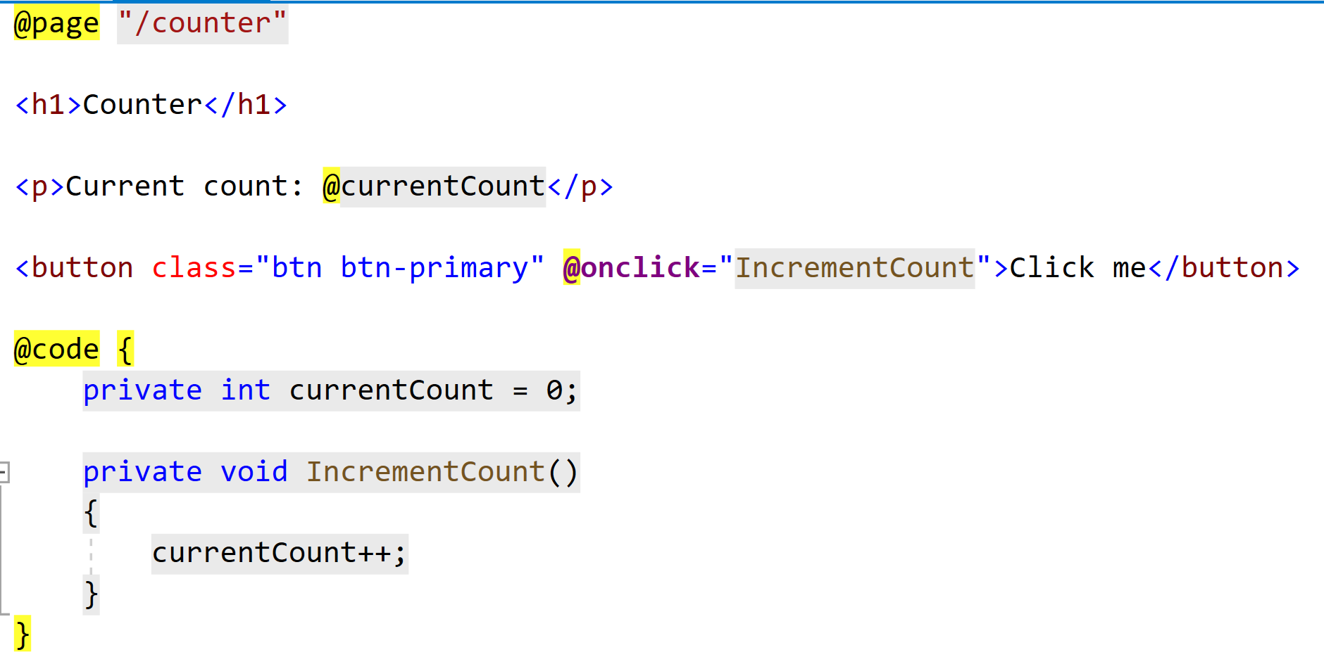
@page directive

Slide 8
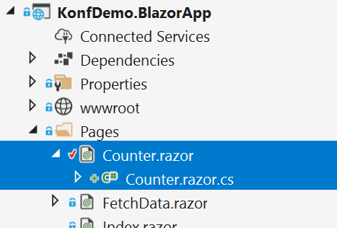
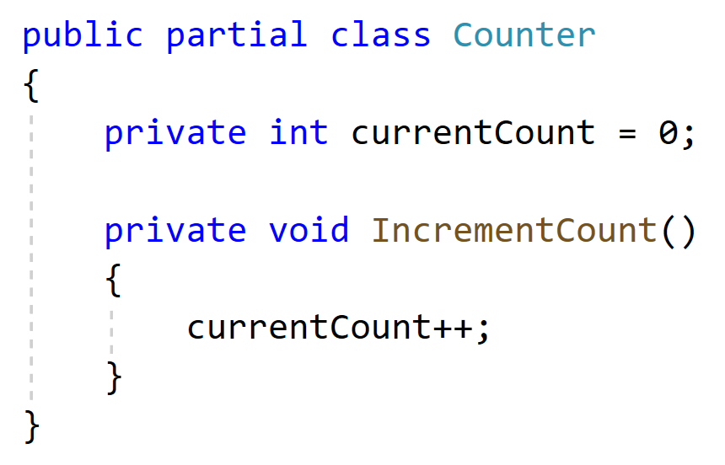
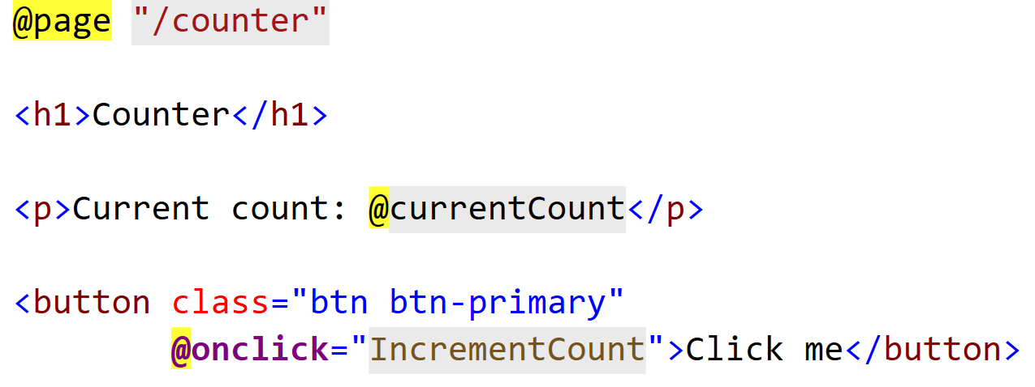
Code Behind (Partial Class)
Counter.razor
Counter.razor.cs

Slide 9
LIVE CODING!

Slide 10
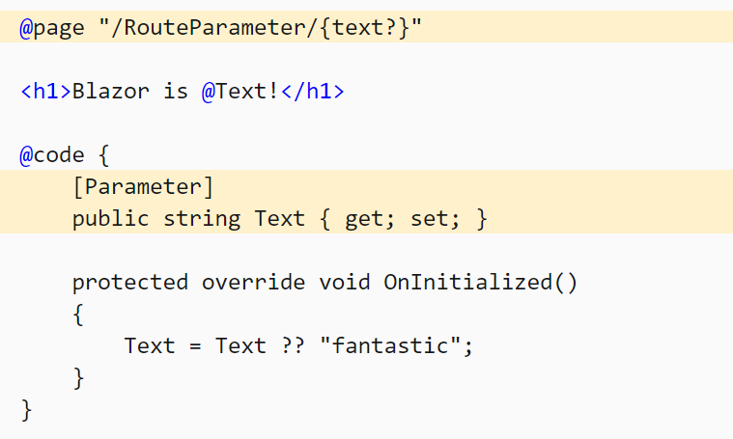
Route Parameters

Slide 11
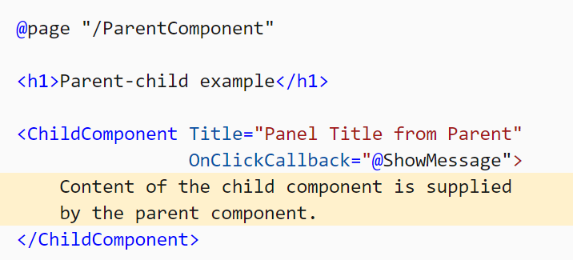
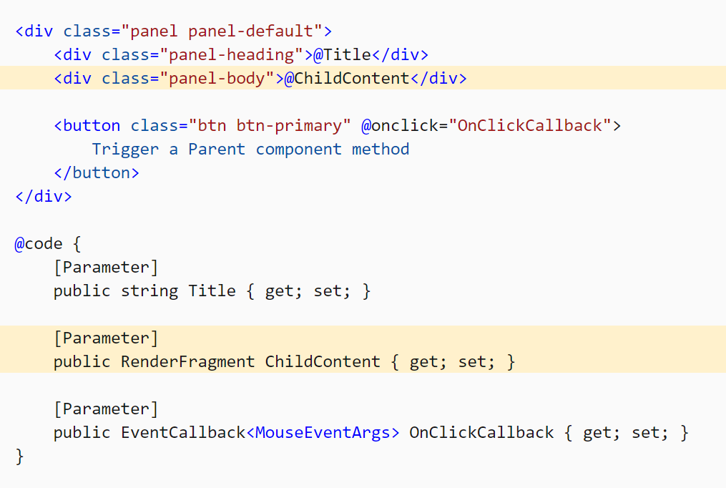
Child Component

Slide 12
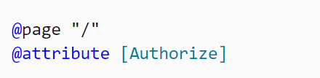
Apply Attributes

Slide 13
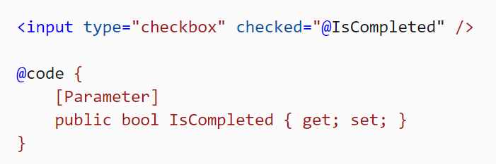


Conditional HTML element attributes
if IsCompleted is true
if IsCompleted is false

Slide 14
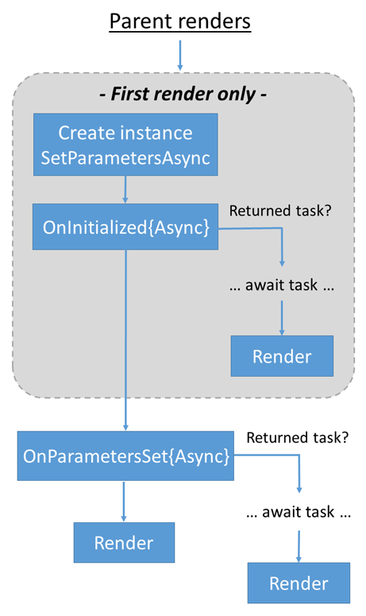
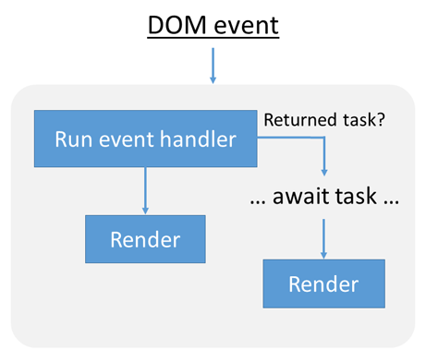
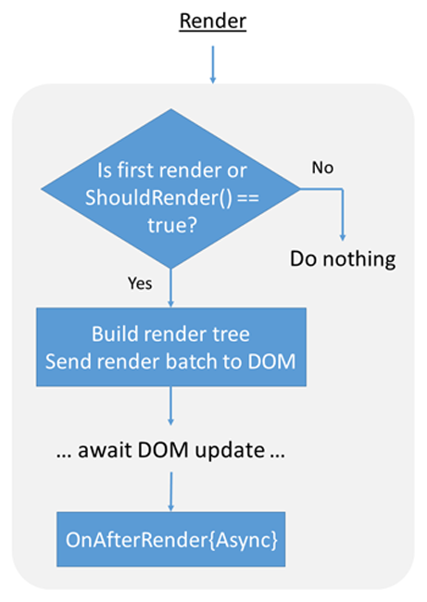
Component Lifecycle

Slide 15
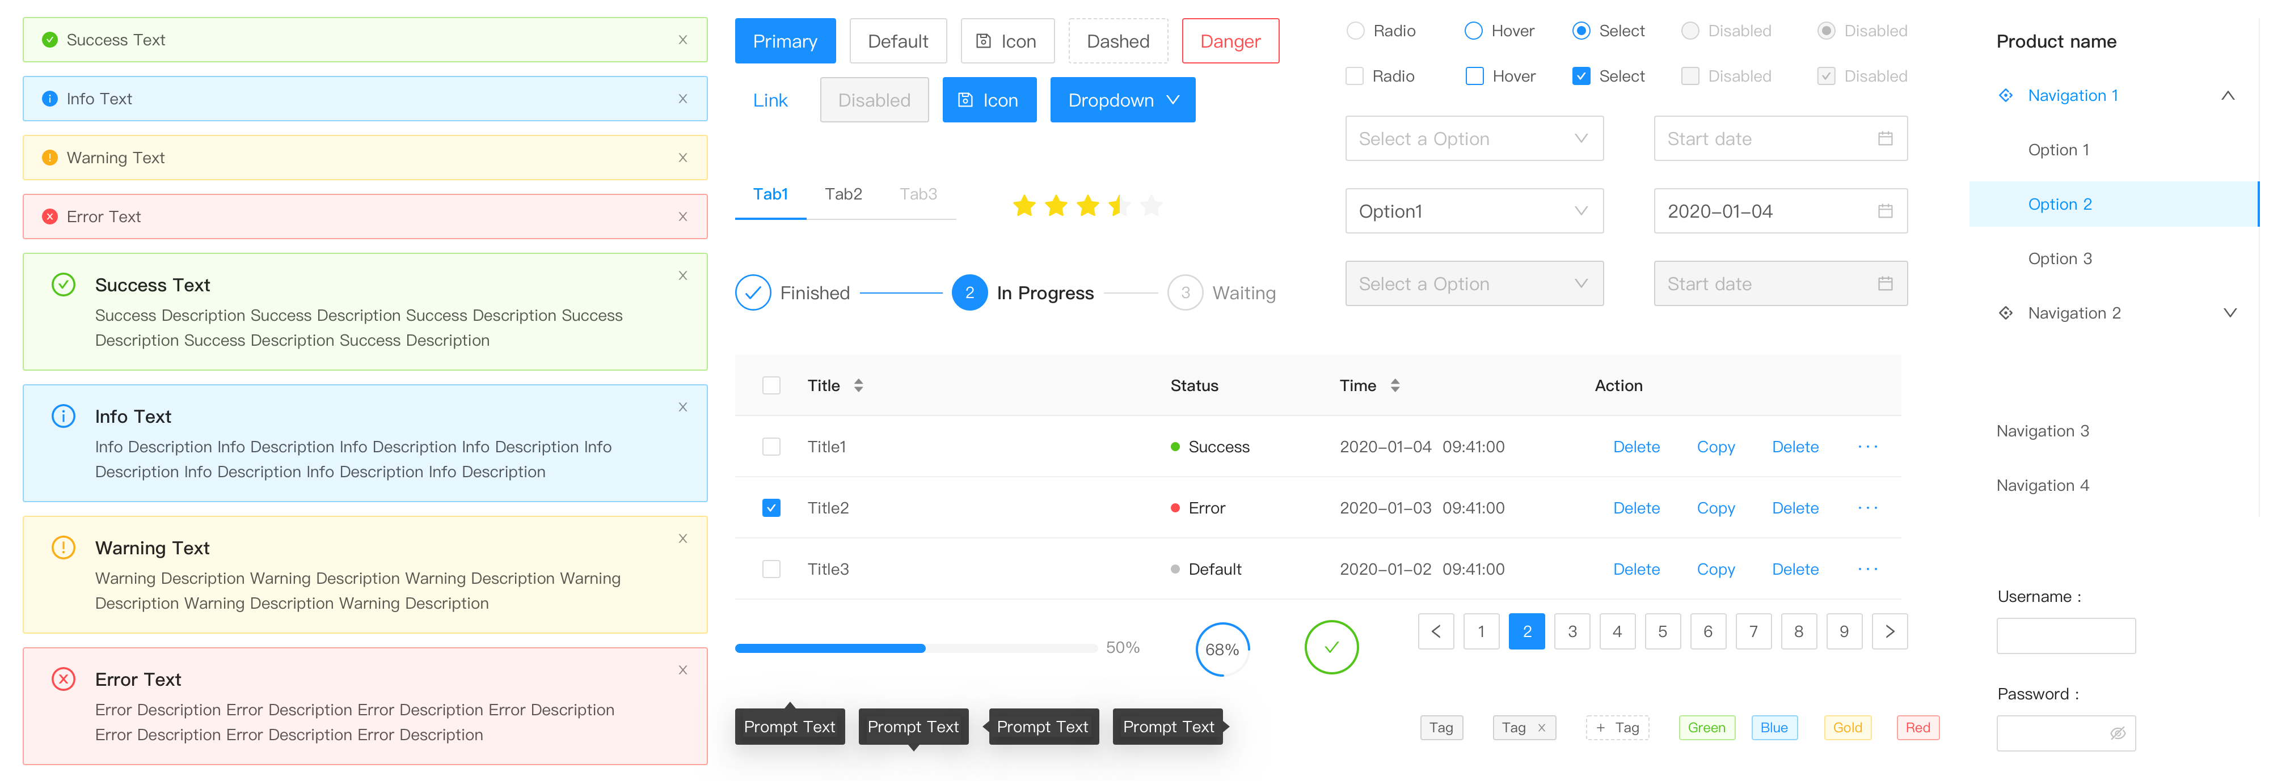
Component Libraries https://github.com/AdrienTorris/awesome-blazor
Blazorise | blazorise.com
MatBlazor |matblazor.com
BlazorStrap | blazorstrap.io
Ant Design Blazor | antblazor.com

Slide 16
Thanks & Questions..?
Presentation & Source Code:
https://github.com/hikalkan/presentations
Web: halilibrahimkalkan.com
Github: @hikalkan
Twitter: @hibrahimkalkan
Halil İbrahim Kalkan

